Slide 1
Chapter 10
The Media
American Democracy Now, 7th edition
Brigid Callahan Harrison
Jean Wahl Harris
Michelle D. Deardorff
Copyright 2022 © McGraw Hill LLC. All rights reserved. No reproduction or distribution without the prior written consent of McGraw Hill LLC.

Slide 2
The Modern Media 1
Media: tools to store and deliver information or data.
Traditionally, we have easily recognized the media: our hometown newspaper, the local television news, and the cable news networks.
Defining the media today is trickier: do tweets from your mayor, Instagrams from your roommate, or Facebook posts from your mom count as media?
We must differentiate between media outlets that distribute unverifiable or opinion-based information and those that disseminate verifiable information.

Slide 3
The Modern Media 2
Media exist in various forms today.
Print media such as newspapers and magazines.
Electronic media, which traditionally means radio and television.
New media: sources of information including websites, blogs, social networking sites, photo- and video-sharing platforms, and apps—and the cellular and satellite technologies that facilitate their use.
Today’s media consumers must exercise a high level of caution when reading, listening, and viewing.

Slide 4
The Political Functions of the Media
Media perform several political functions.
Provide political information.
Help us to interpret events and policies and influence agenda setting in the national political arena.
Provide a forum for political conversations.
Socialize children to the political culture.

Slide 5
Providing Information
Media, particularly the electronic media, are the primary source of information for most individuals.
Media critics especially fault the television networks for injecting entertainment into news shows.
They dub this combination infotainment.

Slide 6
Interpreting Matters of Public Interest and Setting the Public Agenda
Media help people to comprehend and interpret matters of public interest and make informed decisions about policies.
Process often begins with media framing—setting a context for understanding events and matters of shared interest.
Media also help to shape the public agenda—public issues that most demand the attention of government officials.
Media commonly influence the setting of the public agenda by priming—using their coverage to bring particular policies on issues to the public agenda.

Slide 7
Providing a Forum for Conversations About Politics
Historical information flow: media to the public.
Advent of talk radio gave listeners some of their first regular opportunities to express their views publicly, other than the letter to the editor.
Television took note, and call-in shows became common fare on cable television stations.
Internet expanded the ability of people to communicate their views to the greatest degree.

Slide 8
Socializing Children to Political Culture
Media also socialize new generations to the political culture.
For young children, television remains a dominant medium for both entertainment and socialization, although apps are increasingly playing these roles.
TV-viewing toddlers receive regular messages about important cultural values.
Shows such as Sesame Street and Sanjay and Craig send powerful messages about the value of diversity in society.
What is The Voice if not a televised election?

Slide 9
The Press and Politics: A Historical View
Historically, the media have played an essential role in setting the political agenda and shaping public policy.
Early history of media development also raised issues that continue to create conflict about the media’s role in society.

Slide 10
The Early Role of the Press
1790s to the 1830s: the press served primarily as a vehicle for the leaders of political parties.
By the 1830s, the environment had changed.
Higher rates of literacy.
Penny press: a newspaper that sold for a penny.
Introduction of the advertising revenue model.
Gathering and reporting of events, or what we know simply as journalism, flourished.

Slide 11
Yellow Journalism and Muckraking 1
Throughout the last part of the nineteenth century, newspapers competed vigorously with one another for ever-greater shares of readership.
Term yellow journalism signifies an irresponsible, sensationalist approach to news reporting.
Most famous example of the impact of yellow journalism came with both Hearst’s and Pulitzer’s support of the nation’s entry into the Spanish-American War (1898).

Slide 12
Yellow Journalism and Muckraking 2
Hard on the heels of the Spanish-American “newspaper war” came the era of muckraking.
Journalists took on the role of exposing the dark underbelly of government and industry.
Ida Tarbell exposed the oil industry in a series of articles running from 1902 to 1904.
Upton Sinclair’s novel The Jungle (1906) revealed the horrors of the meat-processing industry, leading to passage of the Pure Food and Drug Act and later the establishment of the Food and Drug Administration.

Slide 13
A Widening War for Readership
Yellow journalism waned after World War I.
Began a period in which objectivity was increasingly valued.
New competition arose for newspapers.
Radio, 1920 to 1950; television, 1940s to 1980.
New media, 1980s to present.
Newspapers responded, adapting to new methods.
Consolidating and increasing digital offerings.
Digital paywall: access limited to website subscribers.
Newspapers continue in their efforts.

Slide 14
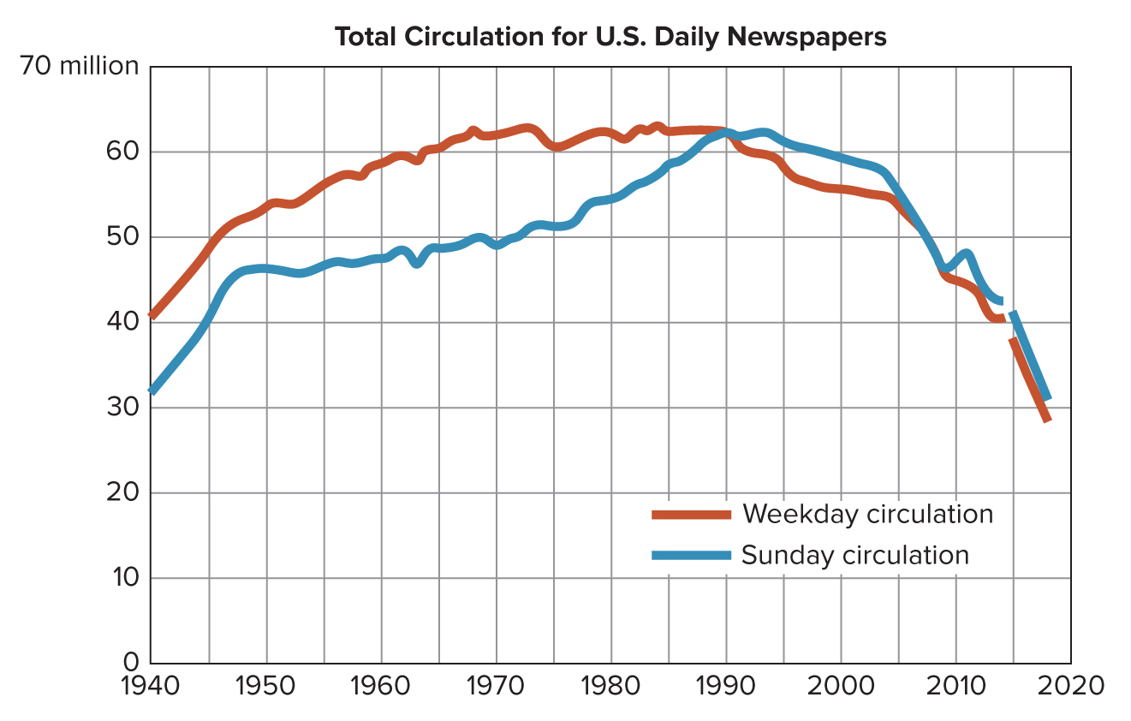
Figure 10.1 Newspaper Circulation Over time
Access the text alternative for slide images.
SOURCE: Pew Research Center.

Slide 15
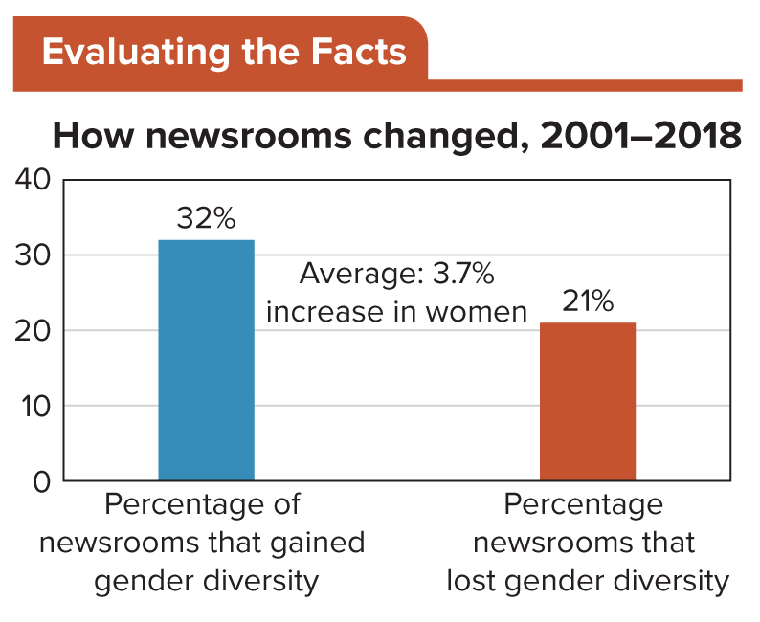
Figure 10.2 Newsroom Employment by Gender
In the past, “newsmen” were in fact newsmen. What does the graph indicate about women’s employment in today’s newsrooms?
Access the text alternative for slide images.
SOURCE: American Society of News Editors

Slide 16
Increasing Diversity in Newsrooms
Among younger journalists, we are likely to see more diversity and that many online publications are more diverse than media outlets based in the print legacy.

Slide 17
The Media Go Electronic: The Radio and Television Revolutions
Radio broadcasts starting in the early 1920s allowed listeners to hear news in real time.
Radio also altered the relationship between politicians and their constituents.
It enabled listeners to hear the voices of their elected leaders.
Television further revolutionized that relationship by making it possible for people to see their leaders.

Slide 18
How Radio Opened Up Political Communication
Radio was the first electronic medium that brought people into direct contact with their leaders.
Beginning in the 1920s, radios became a fixture in American living rooms.

Slide 19
FDR’s Fireside Chats
Franklin D. Roosevelt used radio addresses to overcome his opposition by appealing directly to his constituents.
He often began his fireside chats with the greeting, “Good evening, friends,” highlighting the personal relationship he wished to cultivate.
In all, FDR had 30 fireside chats with Americans over his 12 years as president.

Slide 20
Talk Radio: Talking the Political Talk 1
Radio began to emerge from the shadows of television in the 1970s and 1980s.
Those decades brought a renaissance of sorts for radio, as the medium saw tremendous growth in talk radio—a format featuring conversations and interviews about topics of interest, along with call-ins from listeners.

Slide 21
Talk Radio: Talking the Political Talk 2
In 1987, the Federal Communications Commission (FCC) repealed the fairness doctrine, which had required stations with broadcast licenses to present issues of public importance in a manner that was honest, fair, and balanced.
Since the law’s repeal, partisan radio programming has grown dramatically.
Today listeners tend to tune in to radio hosts who share or reinforce their own opinions.

Slide 22
Television and the Transformation of Campaigns and Elections
TV has been the centerpiece of U.S. home entertainment for a long time.
Hundreds of channels compete for audience share, ending the previous dominance of the three major networks, ABC, NBC, and CBS.
Being telegenic, or looking good on TV, is today almost mandatory for serious political candidates.
Nixon–Kennedy debate of 1960 marked this significant change.

Slide 23
How Americans Use the Media to Get Political Information
As cable channels have increased their viewing audience, the word broadcasting has spawned the term narrowcasting—the practice of aiming media content at specific segments of the public.
This has led to media segmentation, the breaking down of the media in general according to specific audiences they target.

Slide 24
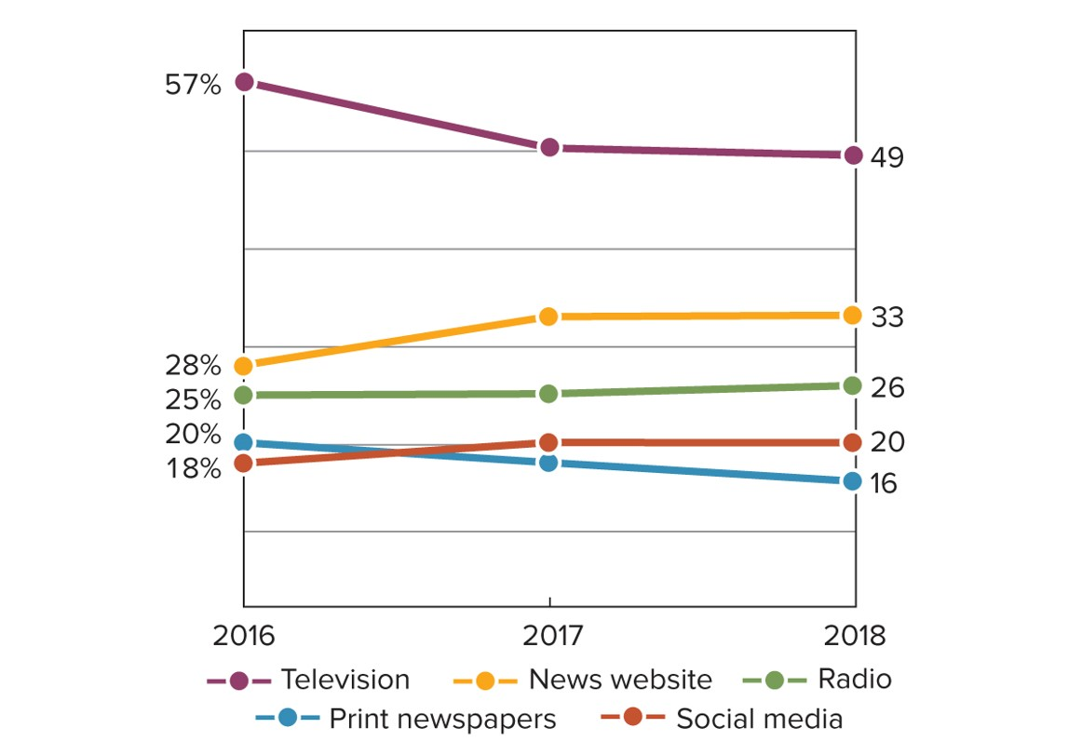
Figure 10.3 Percentage of U.S. Adults Who Often Get Their News from Each Platform
Today, increasing numbers of Americans are getting their news online. Indeed, between 2016 and 2017 alone, the gap between those who often got news on television and those who got news online shrunk from 19 percent to 7 percent.
Access the text alternative for slide images.
SOURCE: Pew Research Center.

Slide 25
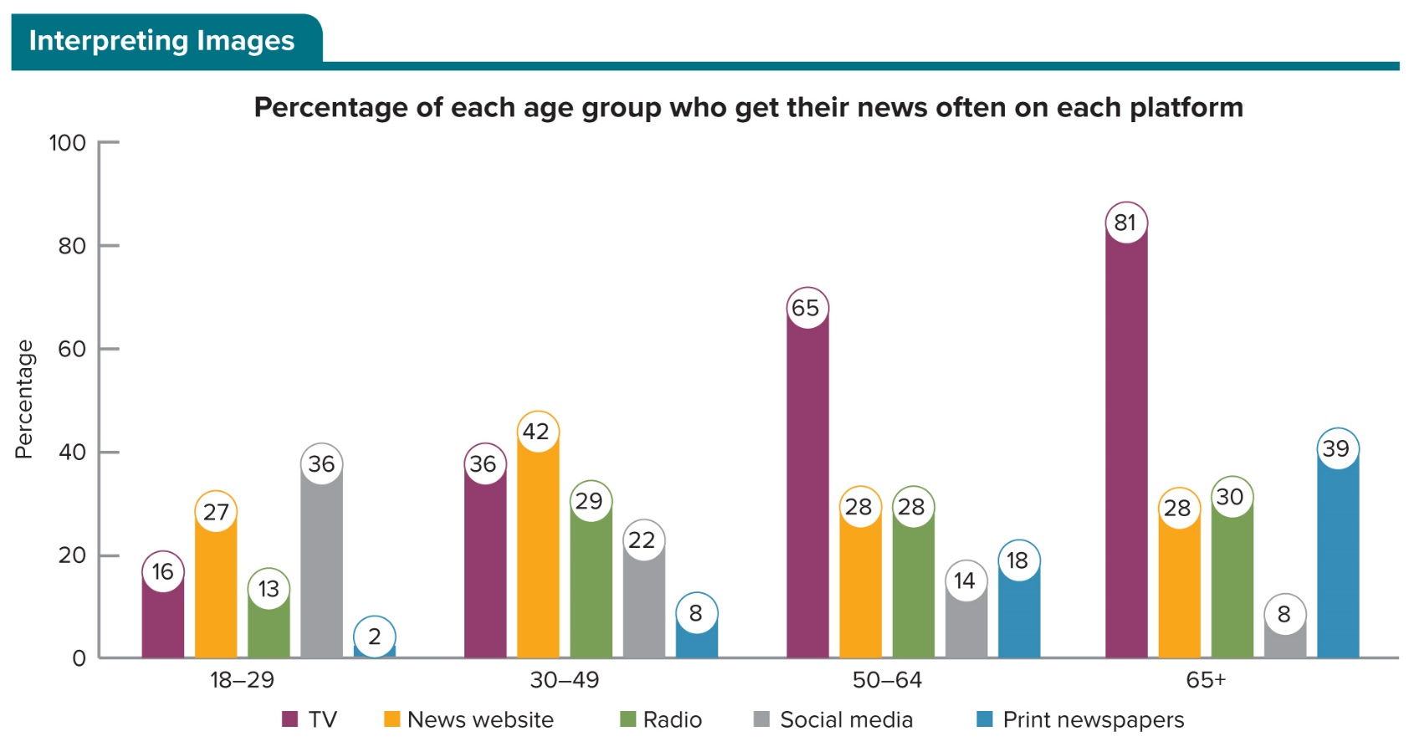
Figure 10.4 Where Americans Get Their News Varies by Age
Access the text alternative for slide images.
SOURCE: Pew Research Center.

Slide 26
Media Consolidation
Increasingly, corporations seek to be universal providers of all our digital needs, and consolidation occurs—where large corporations buy smaller ones and there are fewer and fewer companies’ products available.
Critics fear this will stifle the number of alternative viewpoints presented to the American public.
Media consolidation, however, is countered by the proliferation of media sources.

Slide 27
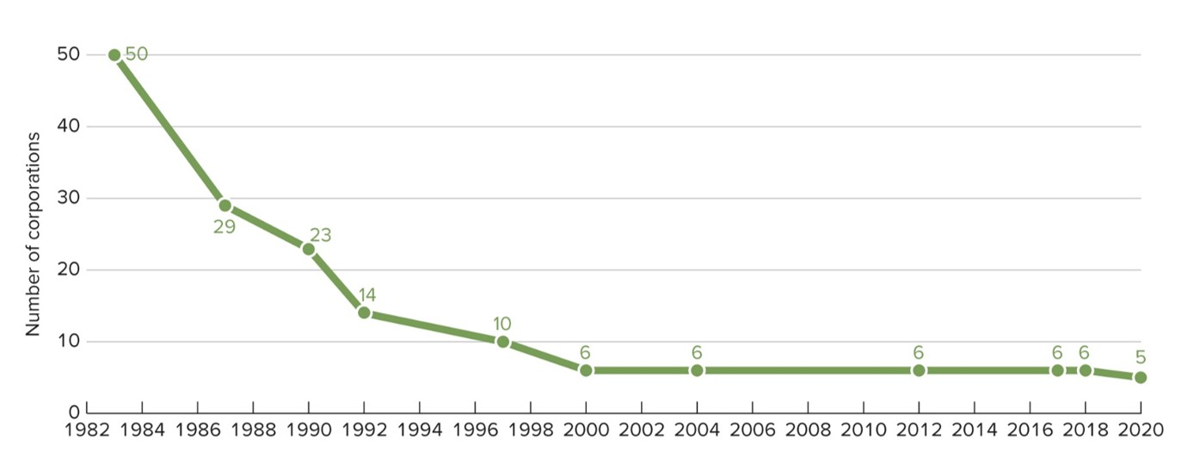
Figure 10.5 Media Consolidation
The number of corporations that bring the majority of news to Americans has shrunk significantly in the past 35 years.

Slide 28
The Proliferation of News Sources and Greater Scrutiny
Rise of cable television and then commercial satellite networks led to the establishment of many new, nonbroadcast networks from which Americans could get their news.
Then in the 1990s, another technological revolution created profoundly more diverse sources of news and information—the Internet.

Slide 29
The Cell-Phone Watchdogs
Rise of cable stations and the Internet have fundamentally changed politics.
Increased number of sources for news also increased scrutiny of government officials and public policy.
Ever-present cell phone video camera means a politician’s every move may be recorded and shared.
Smartphones have also increased consumption of short form and long form news.
Timeframe of “news” has also been affected by the insatiable 24-hour news cycle.

Slide 30
Blogs: The New Penny Papers?
Blogs have become an important component of how individuals communicate and convey information, and how media outlets keep us informed.
Often blogs are more subjective, and their authors are less likely to adhere to professional journalism standards.
Blogs are playing an increasingly important role in shaping the agenda of the traditional media establishment.

Slide 31
Biased Media?
Media critics today are everywhere.
All of them claim that both print and electronic media exhibit bias in their reporting, in their selection of what issues to cover, and in favoring one side of an issue (or one politician) over another.

Slide 32
The Question of Ideological Bias
Long-standing complaint is that the media—particularly big-city papers—evidence a liberal bias.
In recent years, greater attention has been paid to the role that the “conservative media” plays in shaping U.S. politics.
Studies conducted by various political scientists refute the idea that journalists’ personal viewpoints tinge the content of the news in a liberal way.
New stories take the form of a debate.

Slide 33
The Issue of Corporate Bias
Media critics also argue that another form of bias has emerged, corporate bias—and the desire to attract, keep, and please an audience—and that it produces skewed programming.
There is no doubt that profits influence the media to cover the kinds of stories that we want.
“If it bleeds, it leads.”
Fires; political, sports, and sex scandals; and celebrity-heavy news are powerful audience attractors.

Slide 34
Regulation of the Media: Is It Necessary? 1
Government regulates radio and TV stations through the Federal Communications Commission (FCC).
Most of the FCC’s rules concern ownership—the number of outlets a network may own.
Other regulations govern issues like the “decency” of content and how media providers operate.

Slide 35
Regulation of the Media: Is It Necessary? 2
Telecommunications Act of 1996 partly deregulated the industry.
Allowed competition in the industry but also introduced a sometimes-confusing array of consumer options and services.
Large corporate conglomerates have grown and decreased competition, leading to concerns about unbiased presentations of issues.

Slide 36
Review 1
Then—The relationship between the media and consumers was one-way.
Now—Technology has created a two-way relationship between the media and consumers, involving the exchange of a seemingly limitless amount of information of varying quality, targeted to specific audiences.

Slide 37
Review 2
Next:
Will the abundance and the reach of the media overload people with information?
Will people select media sources that serve only to confirm their views?
Will new technologies continue to change the nature of the news business?

Slide 38
End of Main Content
Copyright 2022 © McGraw Hill LLC. All rights reserved. No reproduction or distribution without the prior written consent of McGraw Hill LLC.

Slide 39
Accessibility Content: Text Alternatives for Images

Slide 40
Figure 10.1 Newspaper Circulation Over time - Text Alternative
Return to parent-slide containing images.
Graph shows a slow increase in news daily circulations from 1940 to 1990 and the precipitous drop from over 60 million to 35 million in 2016. Sunday editions surged to a high in the mid-nineties and dropped to less than 40 million after that as well.
Return to parent-slide containing images.

Slide 41
Figure 10.2 Newsroom Employment by Gender - Text Alternative
Return to parent-slide containing images.
Horizontal axis represents newsrooms gain and loss, while the vertical axis represents percentage ranging from 0 to 40 in increments of 10.
The data (in percentage) is as follows:
Newsrooms gained gender diversity, 2001 to 2018: 32; and newsrooms lost gender university, 2001 to 2018: 21.
The average increase in women is 3.7 percent.
Return to parent-slide containing images.

Slide 42
Figure 10.3 Percentage of U.S. Adults Who Often Get Their News from Each Platform - Text Alternative
Return to parent-slide containing images.
Horizontal axis represents year, while vertical axis represents percentage.
The data (in percentage) for different platforms is as follows:
Television:
Curve begins in 2016 at 57 and ends in 2018 at 49 passing through the coordinate (2017, 50).
New website:
Curve begins in 2016 at 28 and ends in 2018 at 33 passing through the coordinate (2017, 33).
Radio:
Curve begins in 2016 at 25 and ends in 2018 at 26 passing through the coordinate (2017, 25).
Print newspapers:
Curve begins in 2016 at 20 and ends in 2018 at 16 passing through the coordinate (2017, 18).
Social media:
Curve begins in 2016 at 18 and ends in 2018 at 20 passing through the coordinate (2017, 19).
Note: All data is approximate.
Return to parent-slide containing images.

Slide 43
Figure 10.4 Where Americans Get Their News Varies by Age - Text Alternative
Return to parent-slide containing images.
Horizontal axis represents age group, while vertical axis represents percentage ranging from 0 to 100 in increments of 20.
The data (in percentage) is as follows:
18 to 29:
TV: 16; news website: 27; radio: 13; social media: 36; and print newspapers: 2.
30 to 49:
TV: 36; news website: 42; radio: 29; social media: 22; and print newspapers: 8.
50 to 64:
TV: 65; news website: 28; radio: 28; social media: 14; and print newspapers: 18.
65 plus:
TV: 81; news website: 28; radio: 30; social media: 8; and print newspapers: 39.
Return to parent-slide containing images.

